Slide 1
Week 1(Introduction):
Problem solving with computers, Definition of a Problem, Program design, Debugging, Types of errors in programming, Documentation

Slide 2
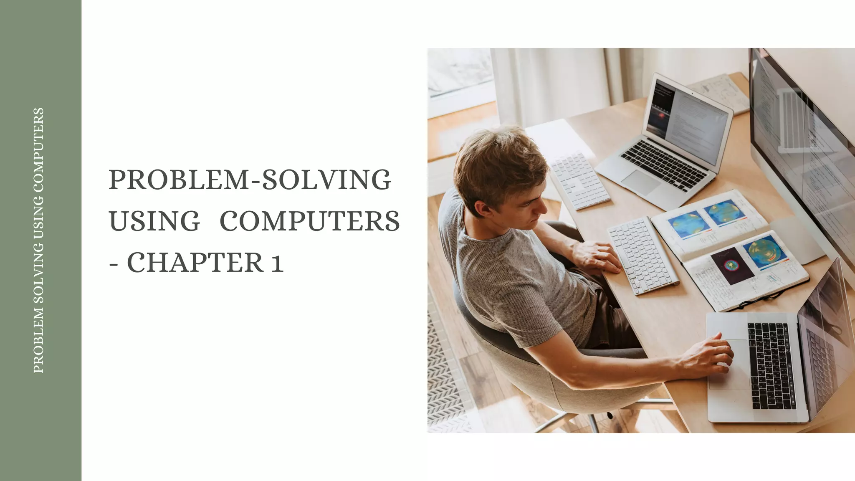

Slide 3
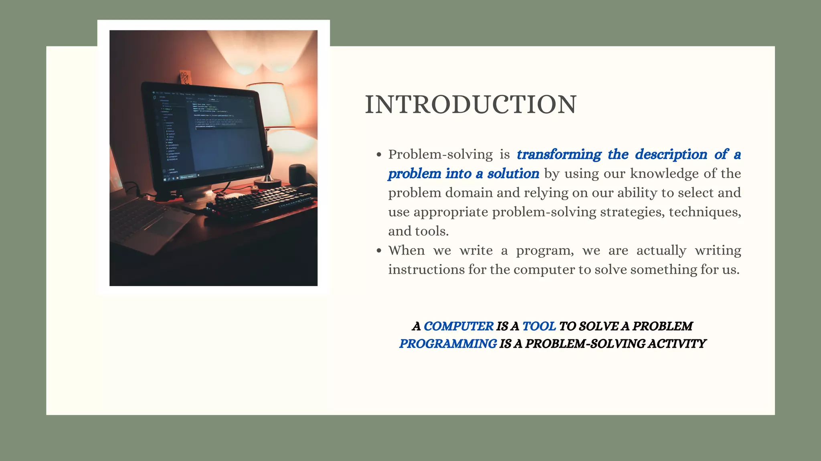

Slide 4
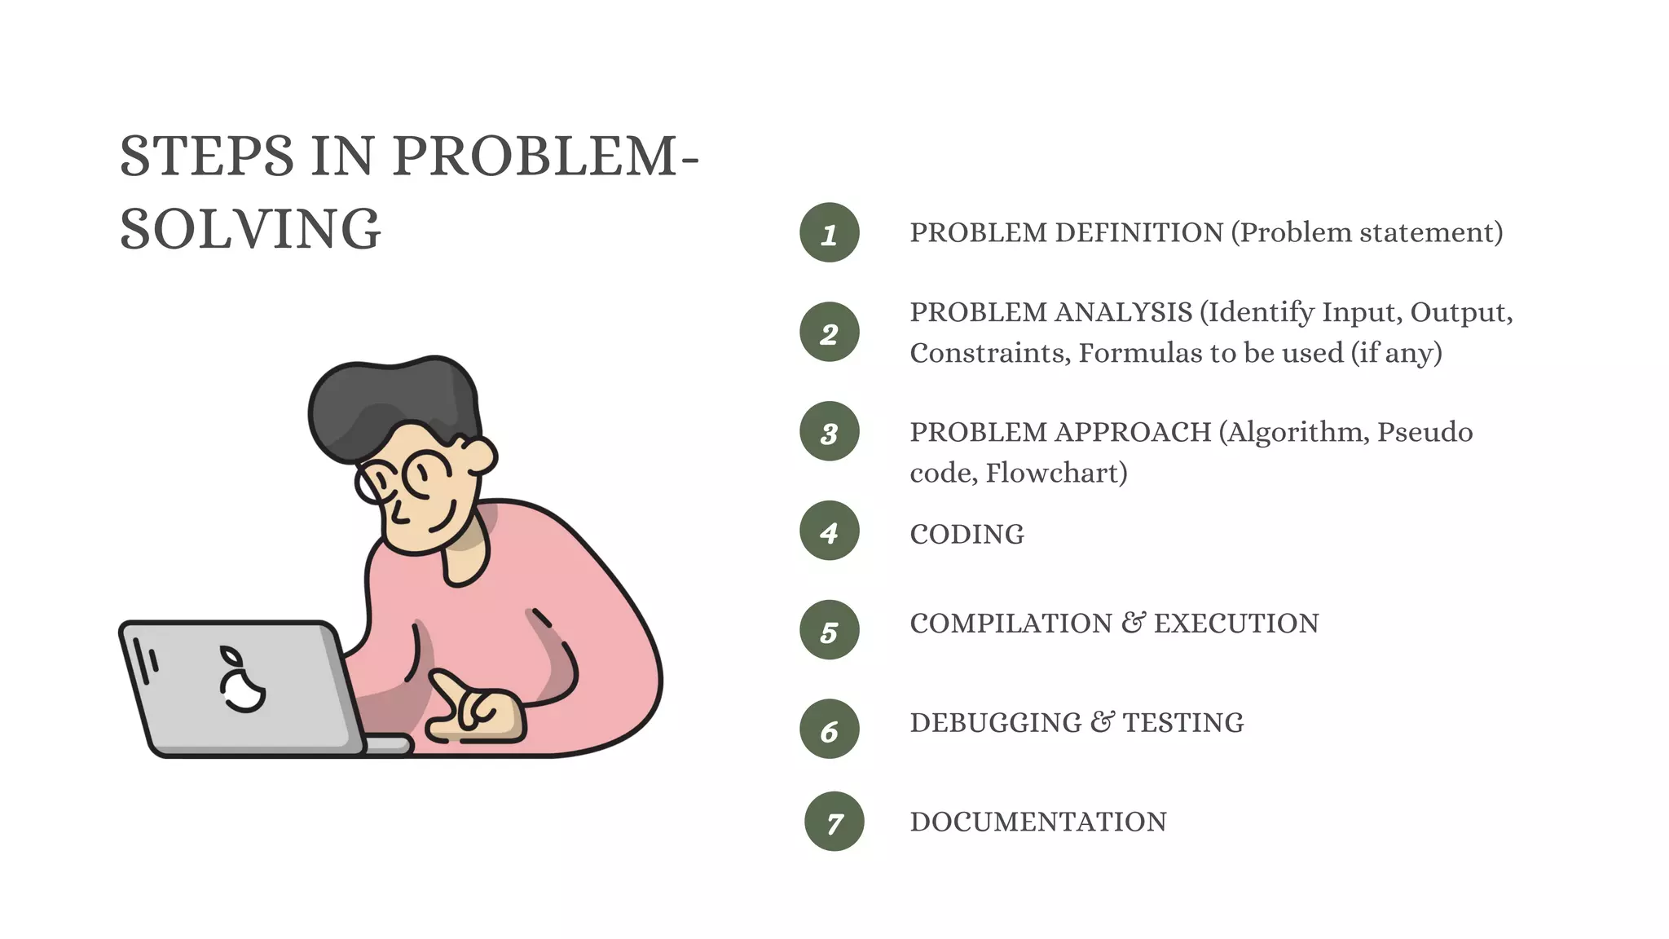

Slide 5
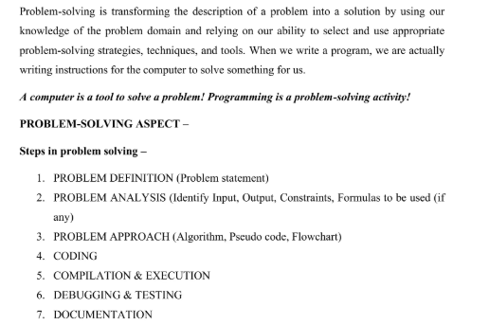

Slide 6
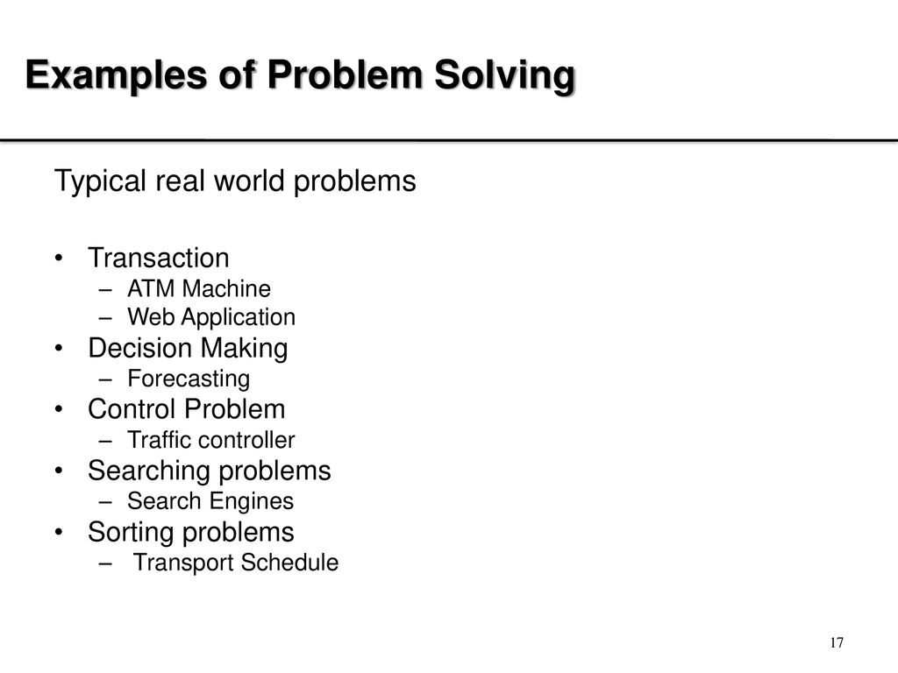

Slide 7
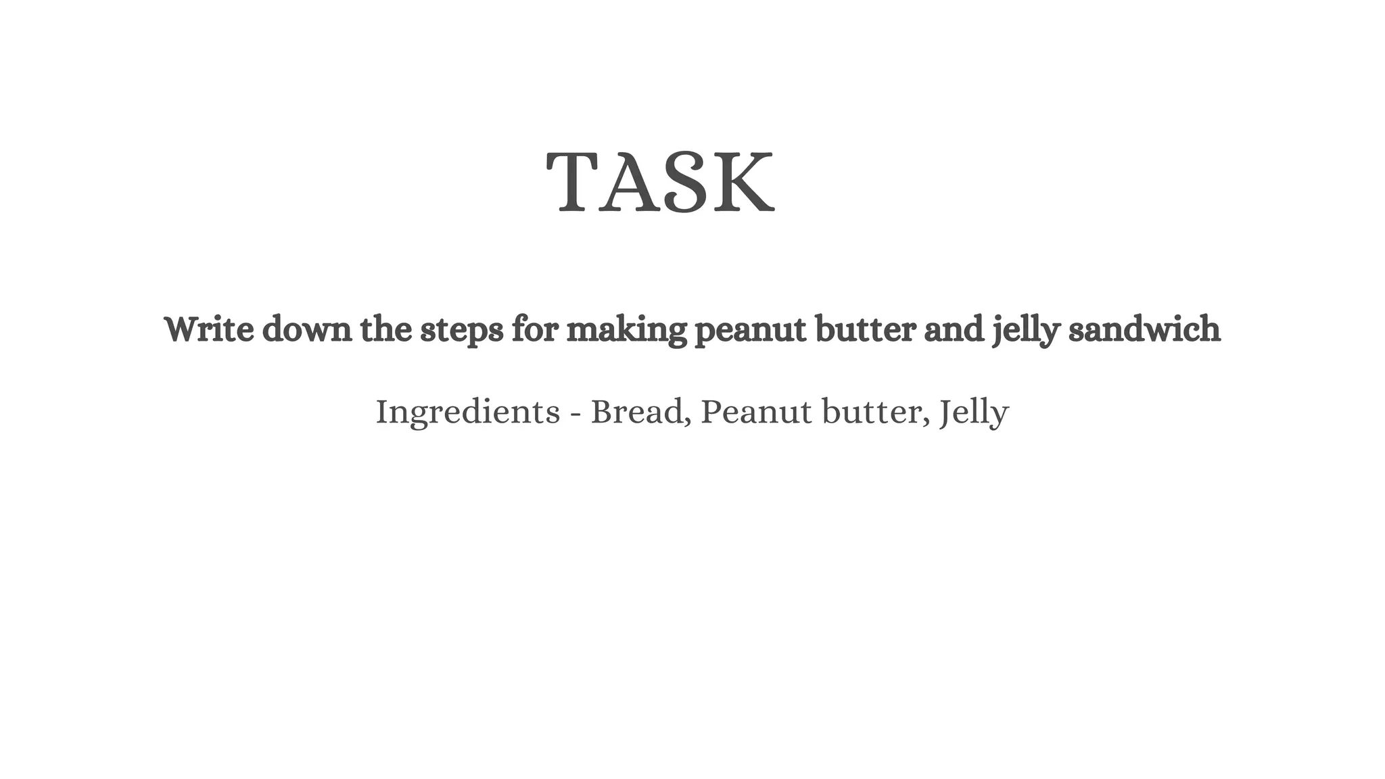

Slide 8
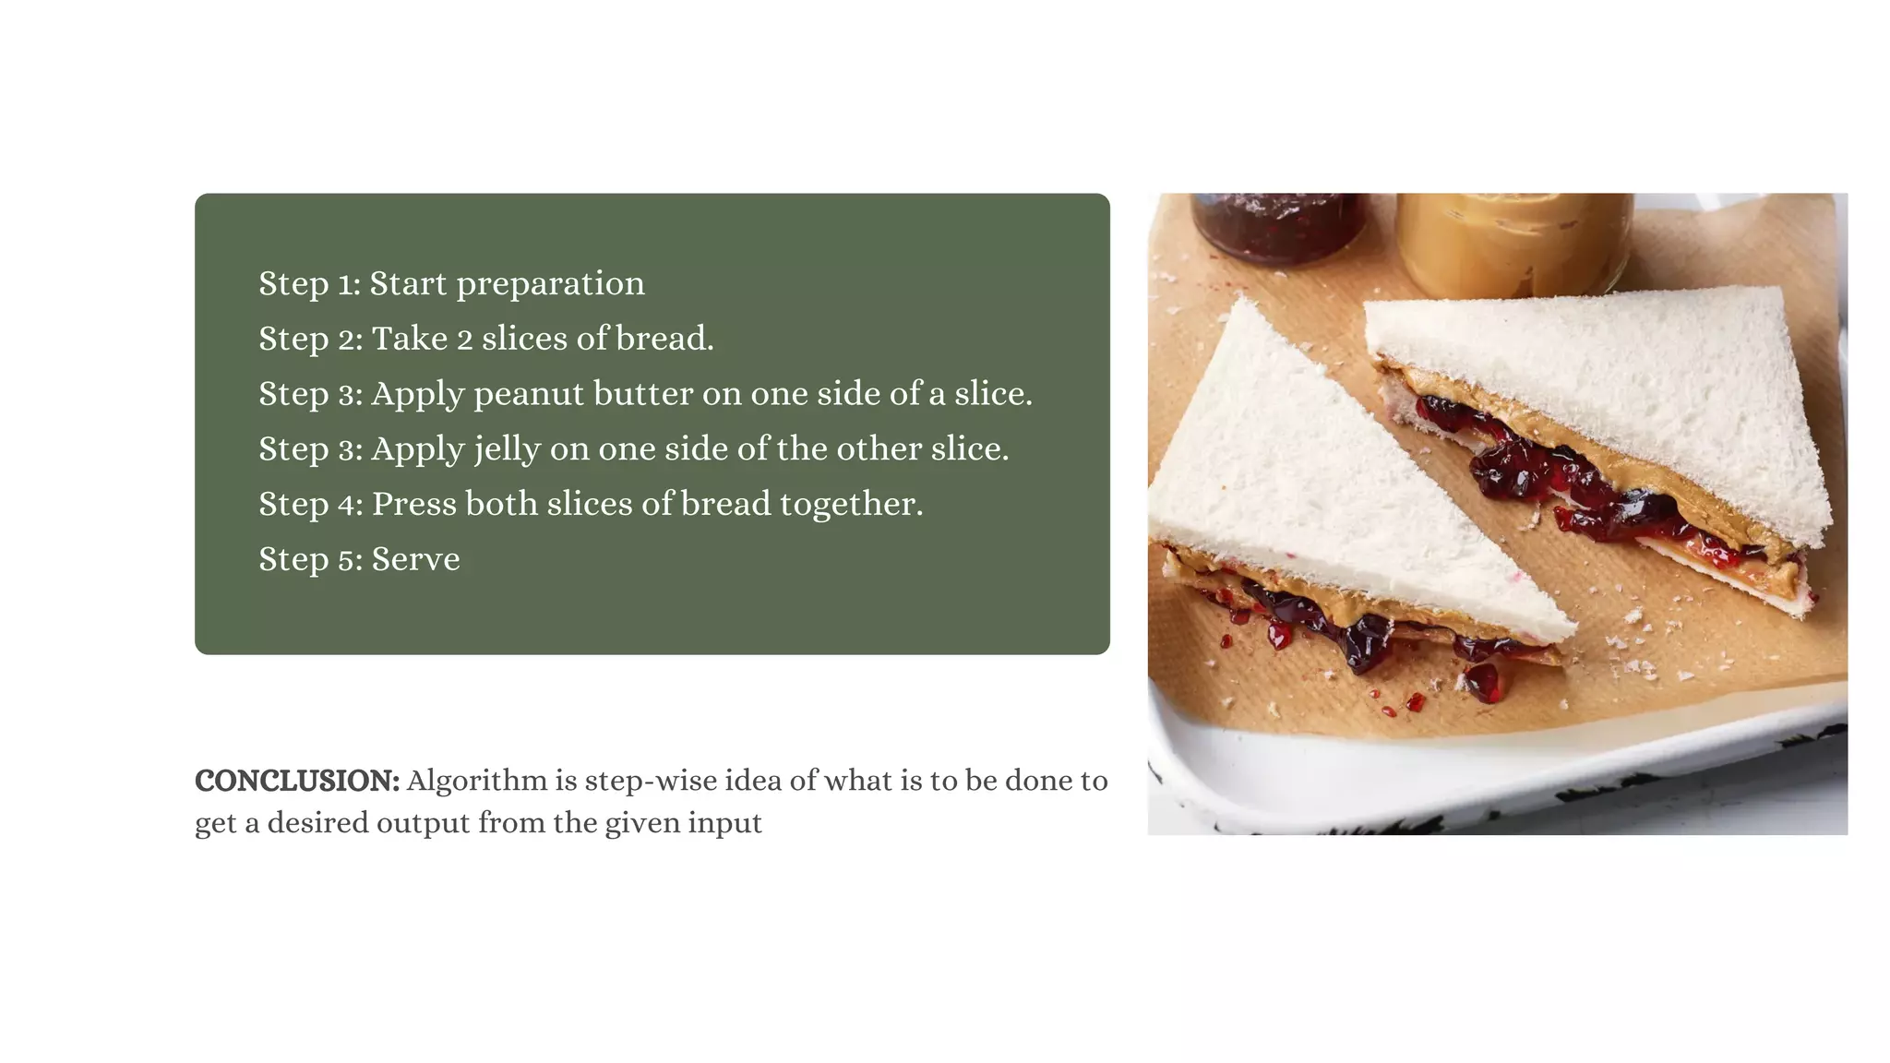

Slide 9
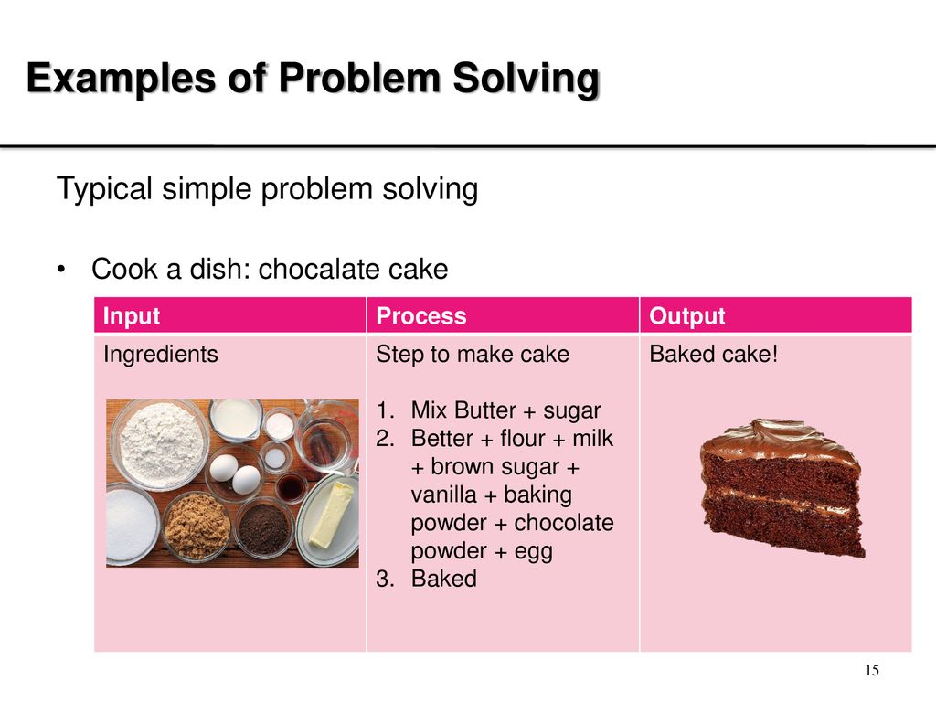

Slide 10
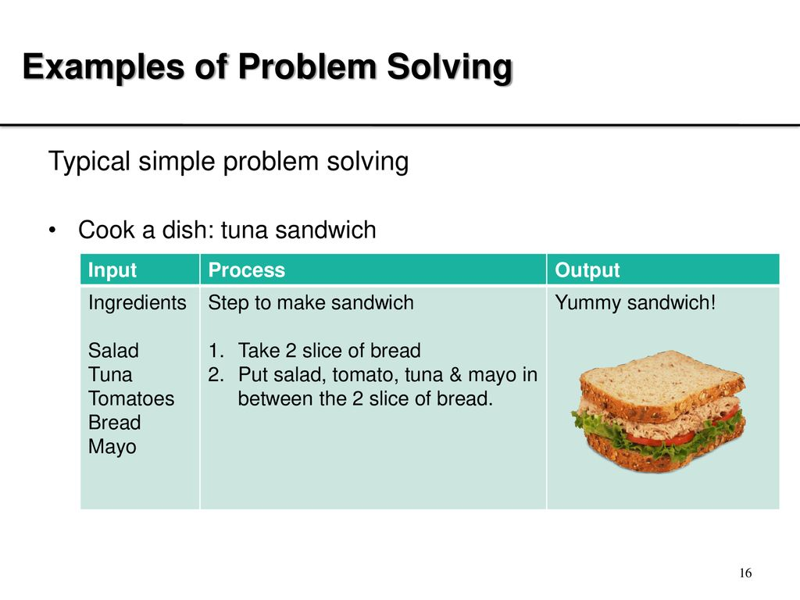

Slide 11
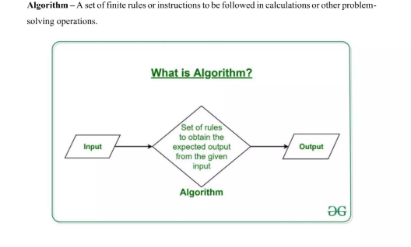

Slide 12
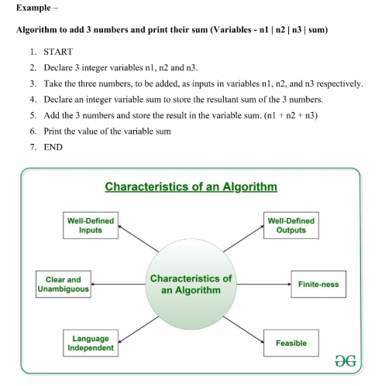

Slide 13
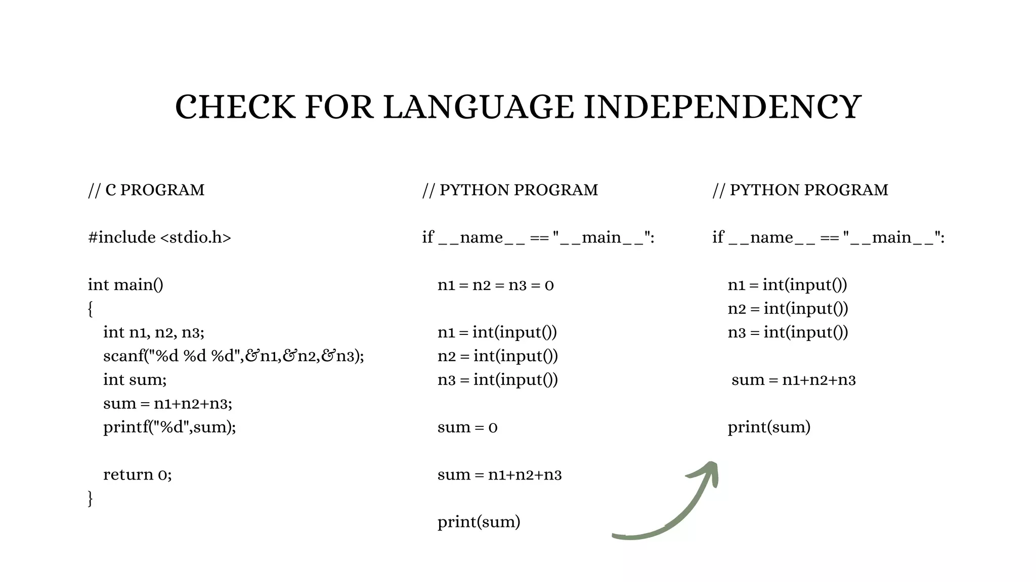

Slide 14
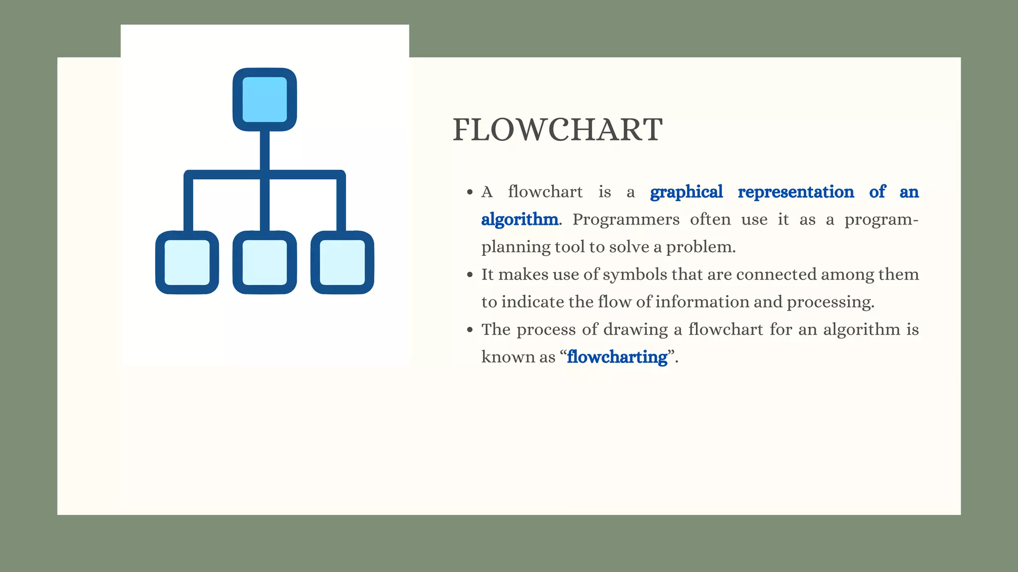

Slide 15
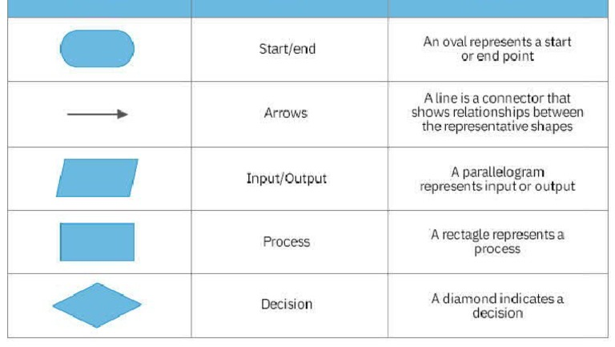
Symbols Used In Flow Chart

Slide 16
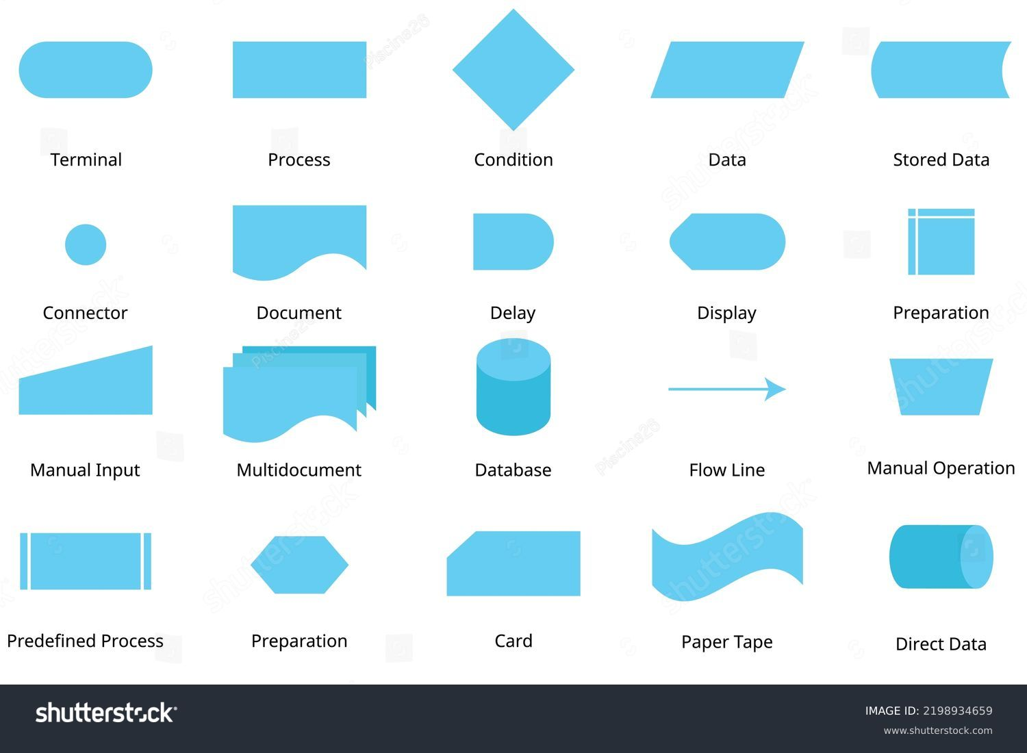

Slide 17
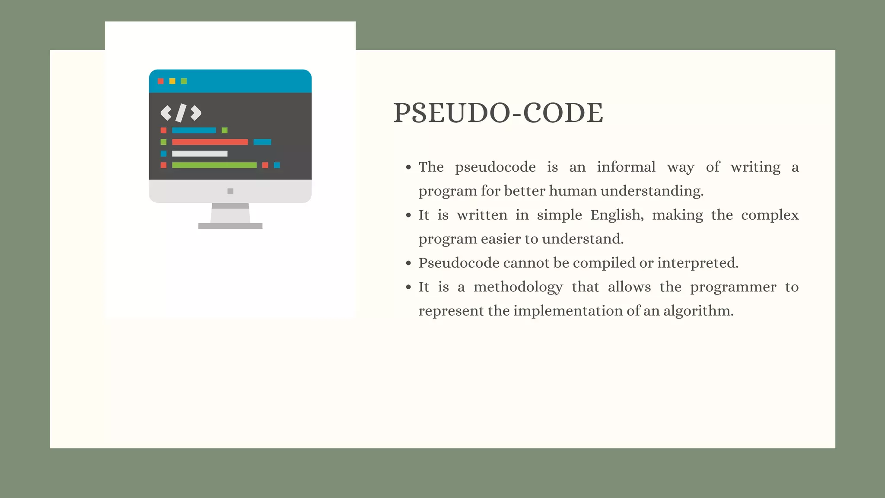

Slide 18
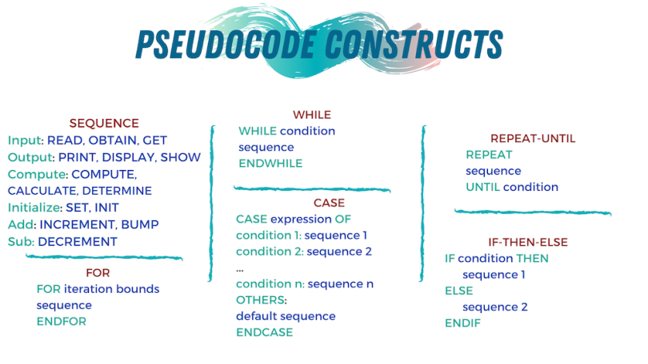

Slide 19
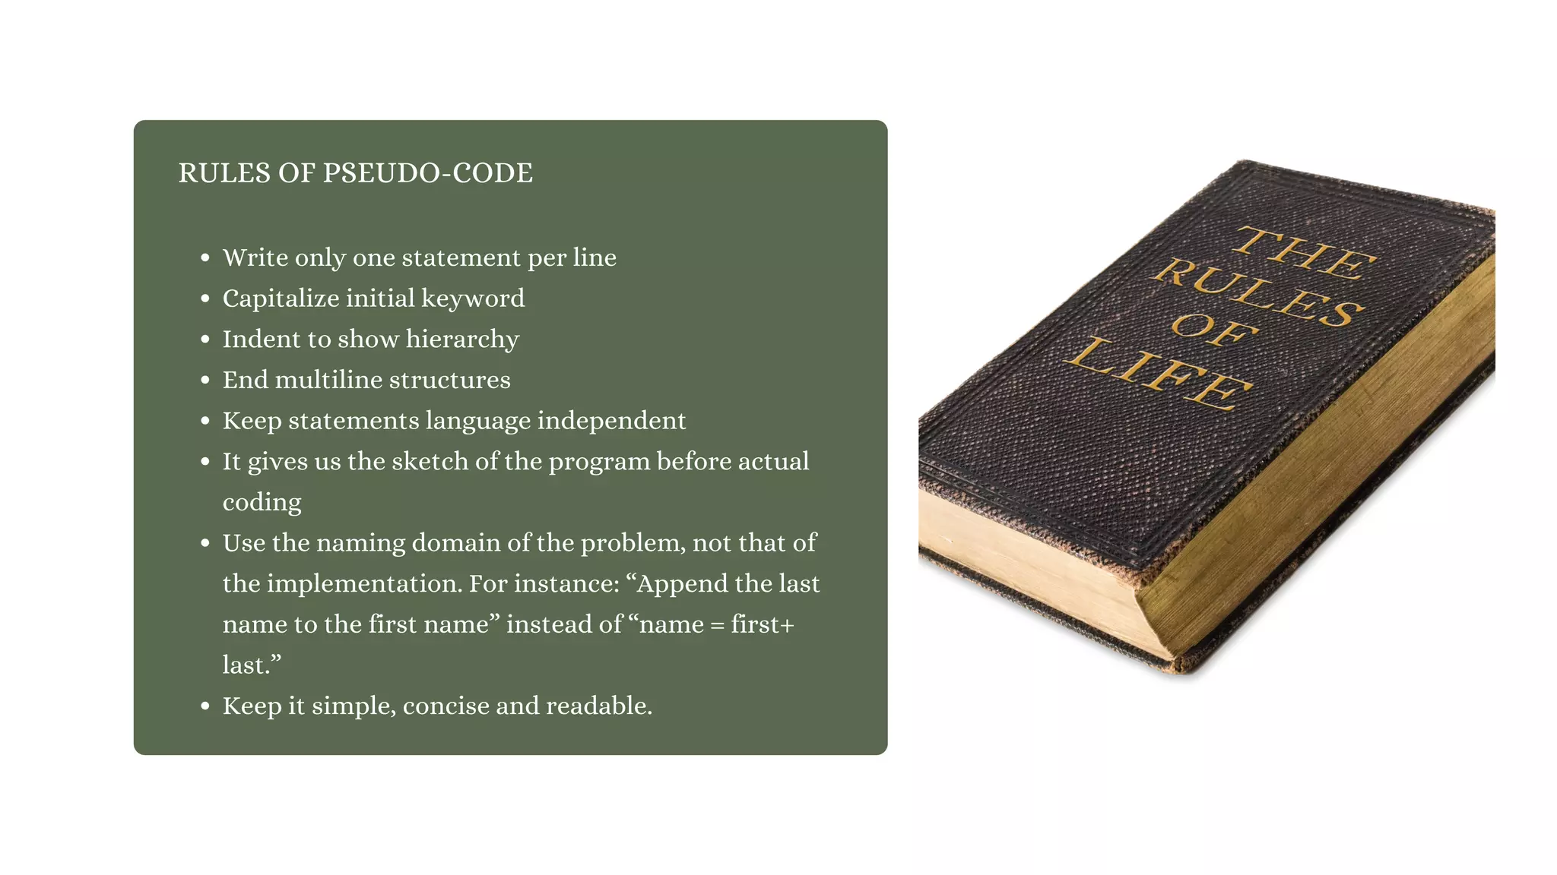

Slide 20
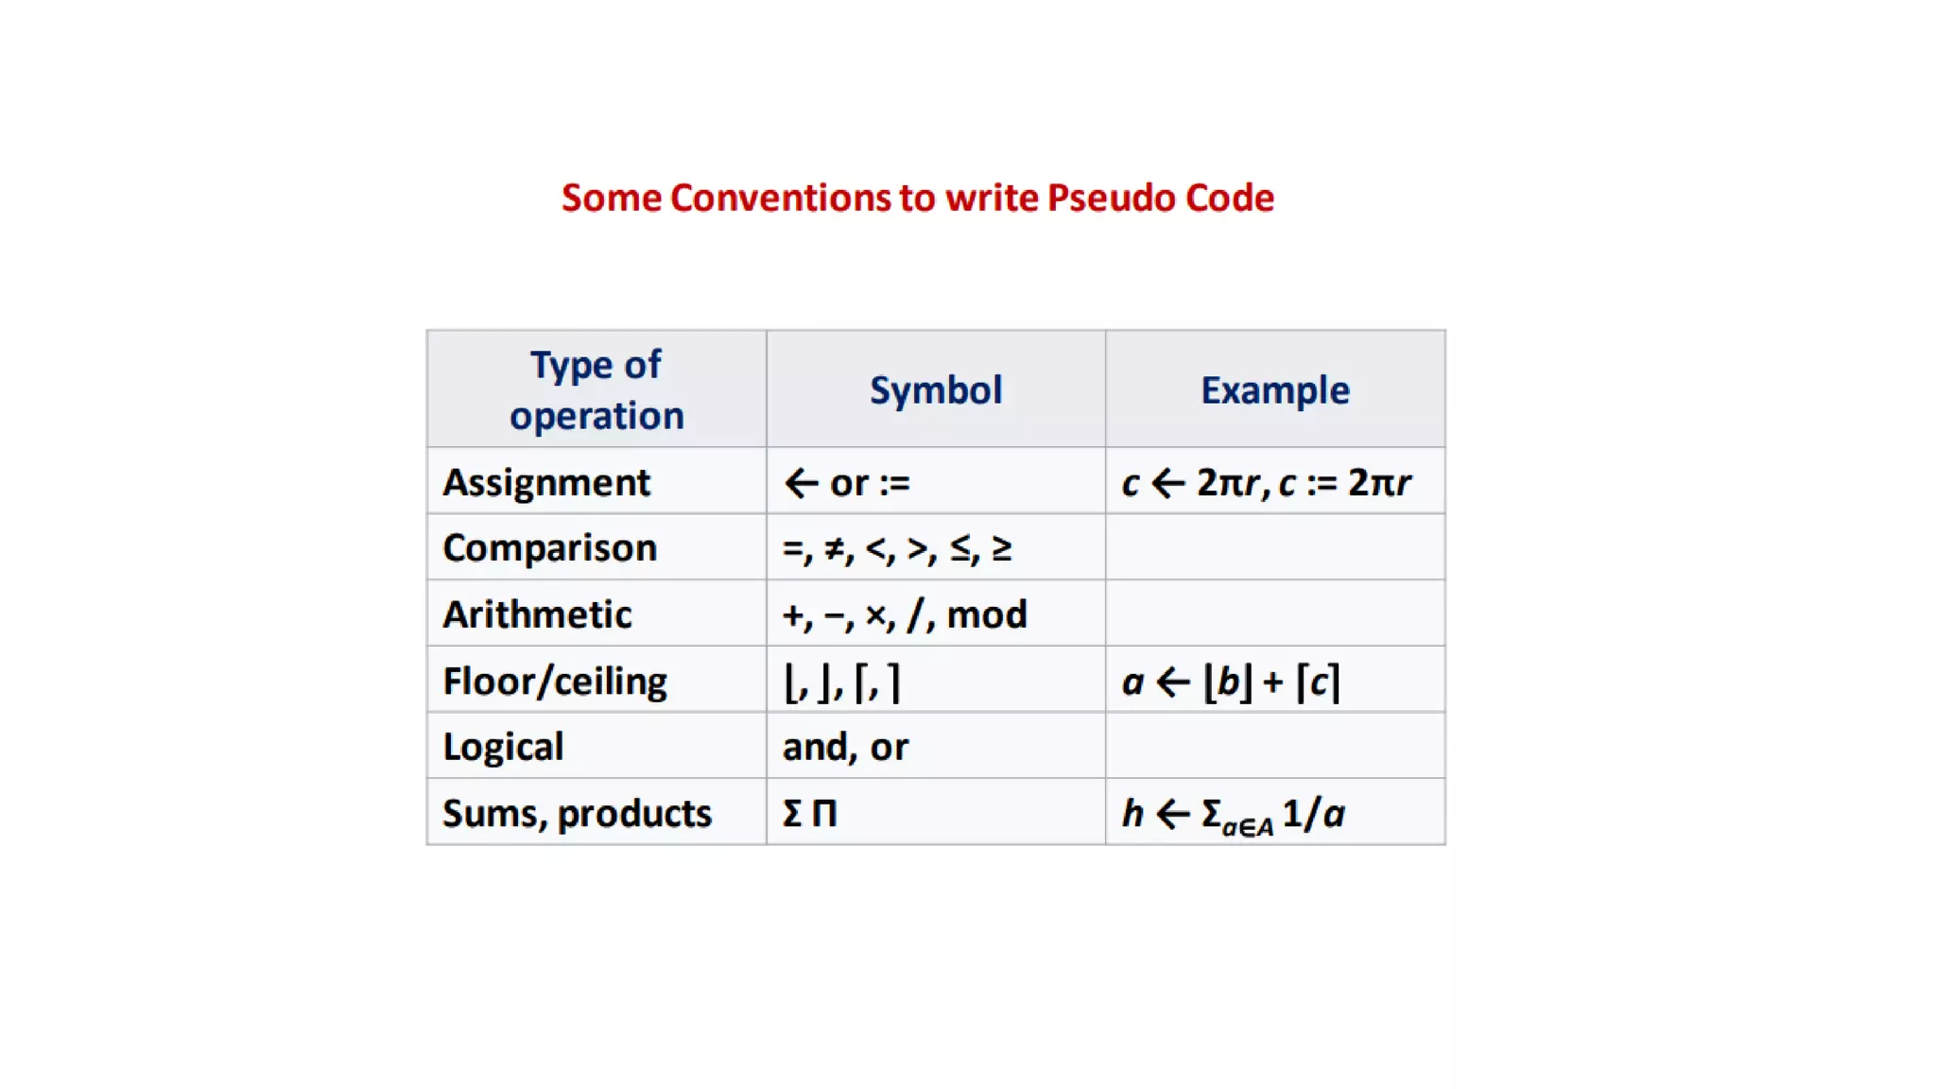

Slide 21
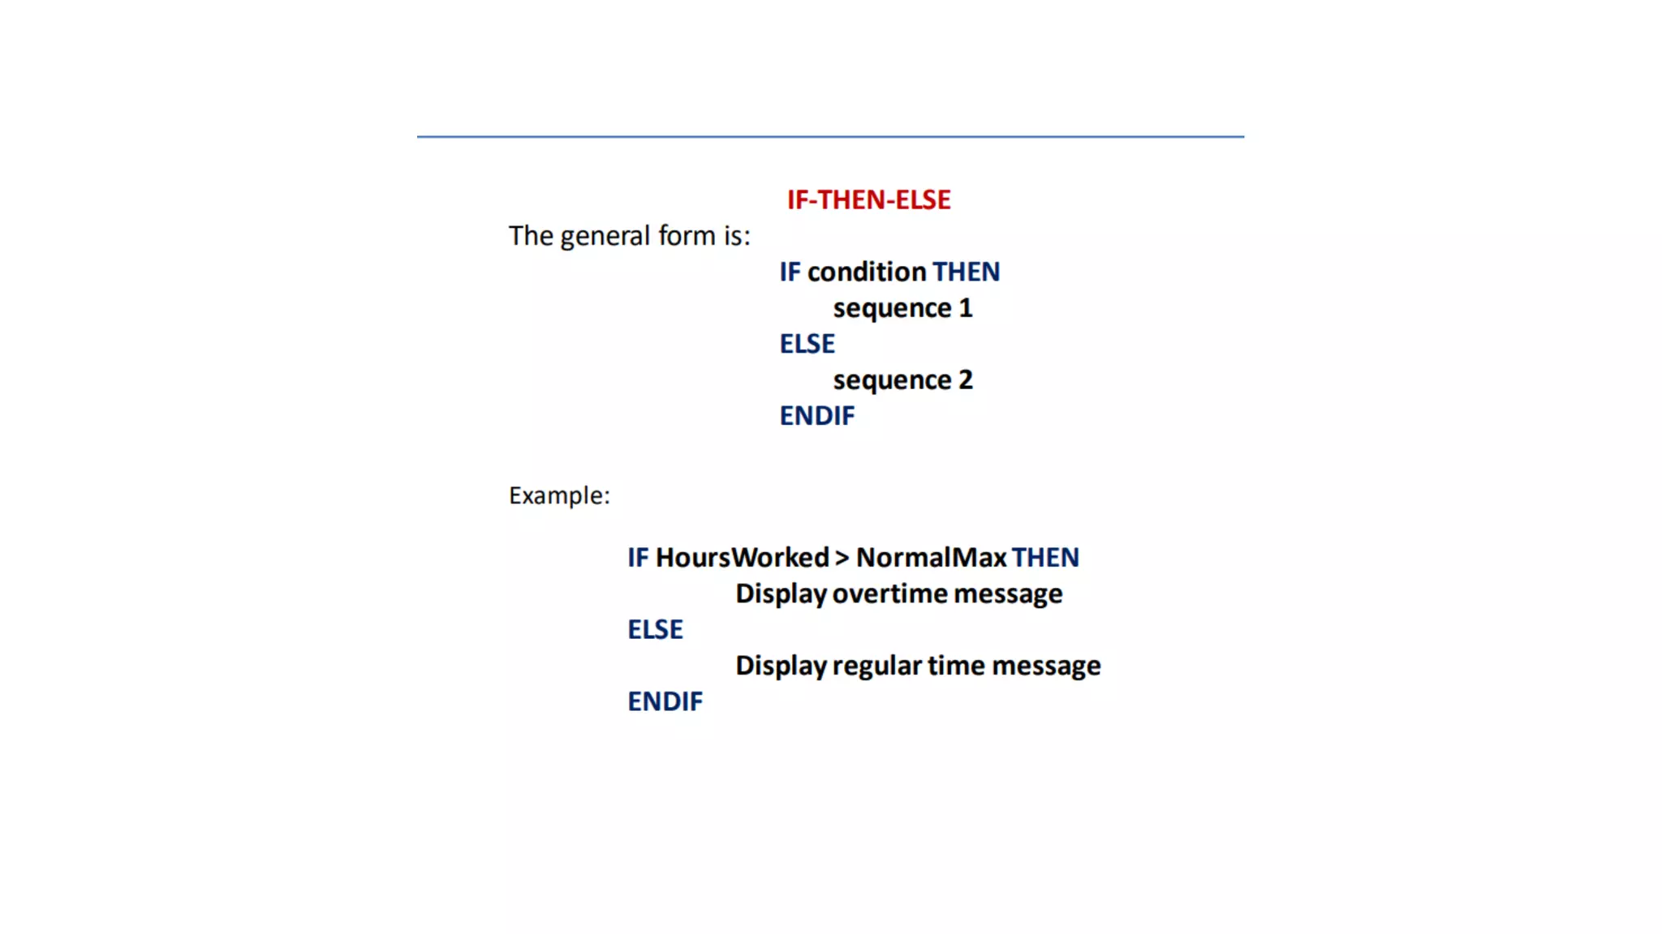

Slide 22
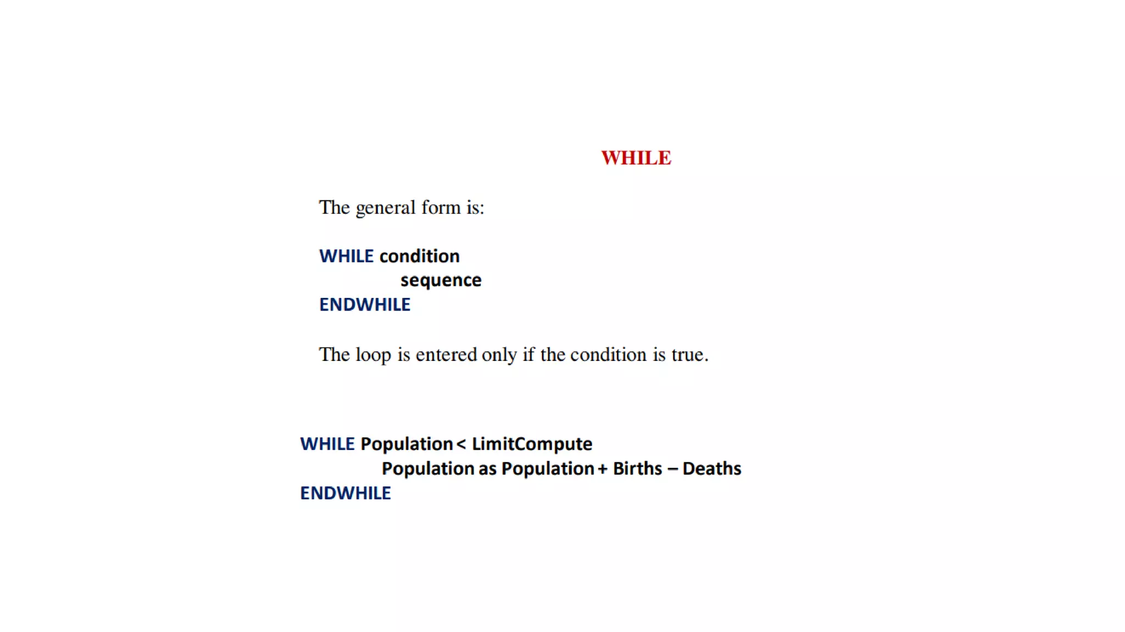

Slide 23
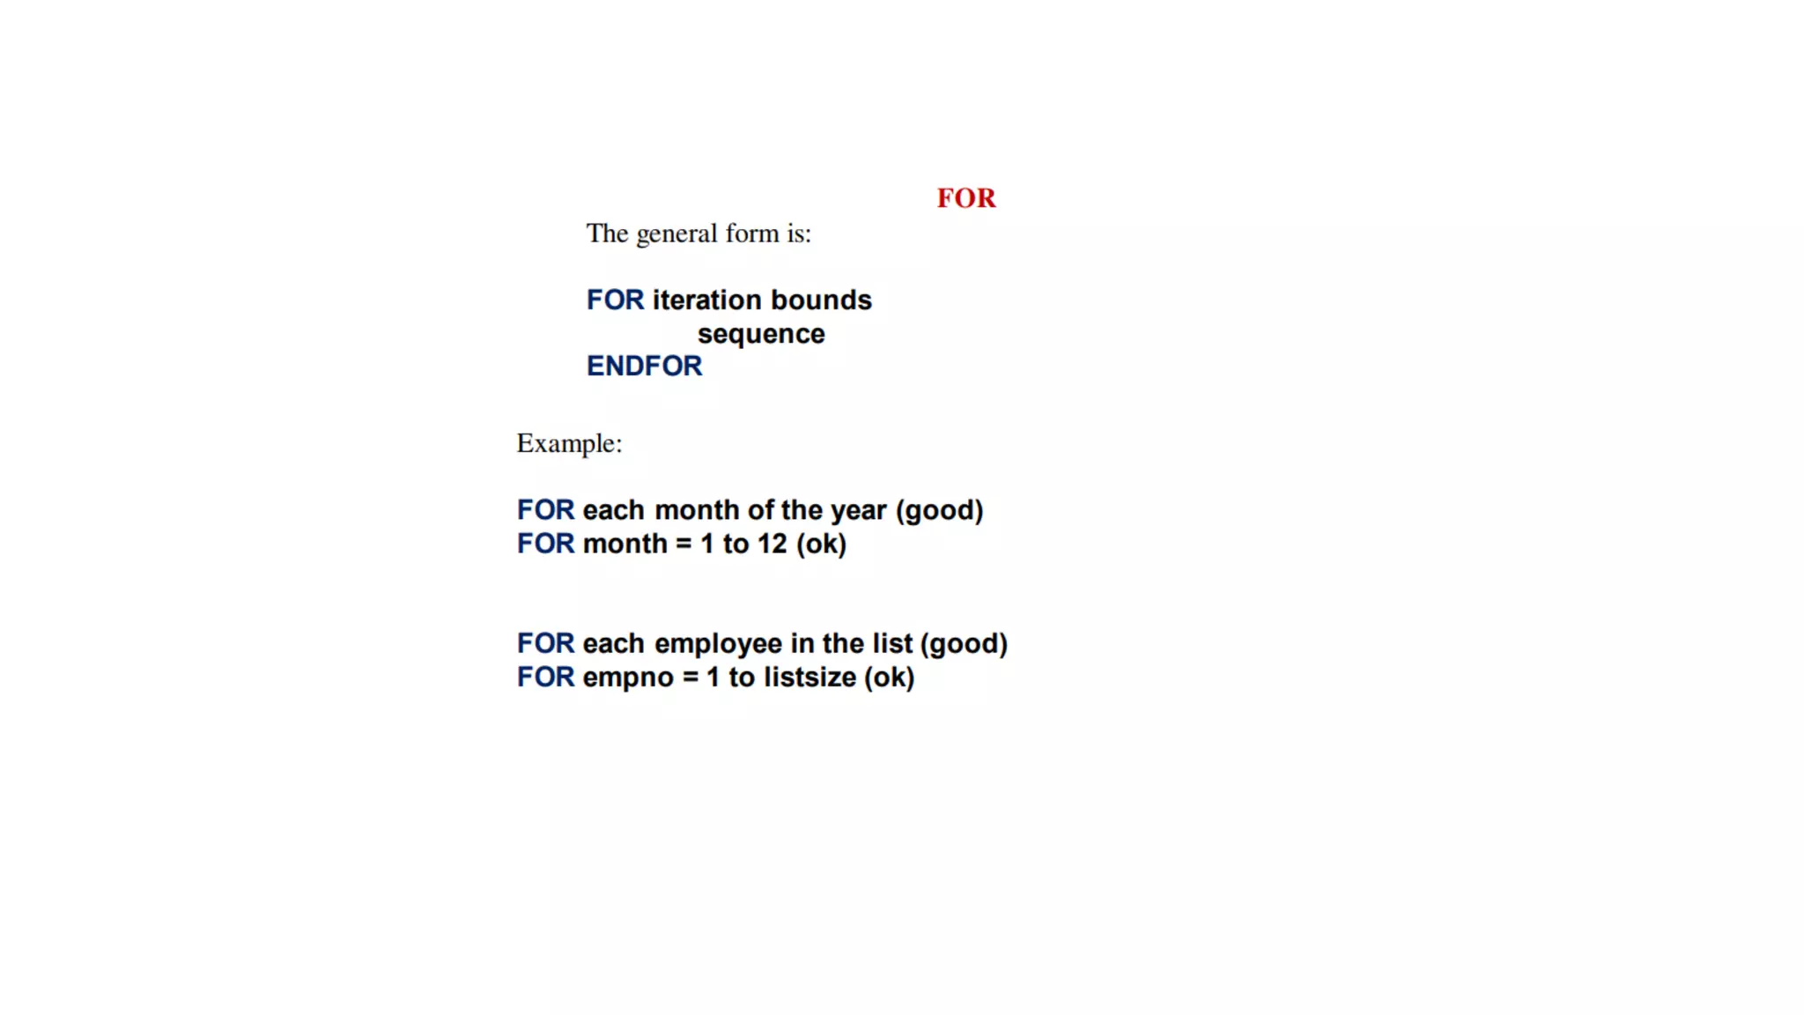

Slide 24
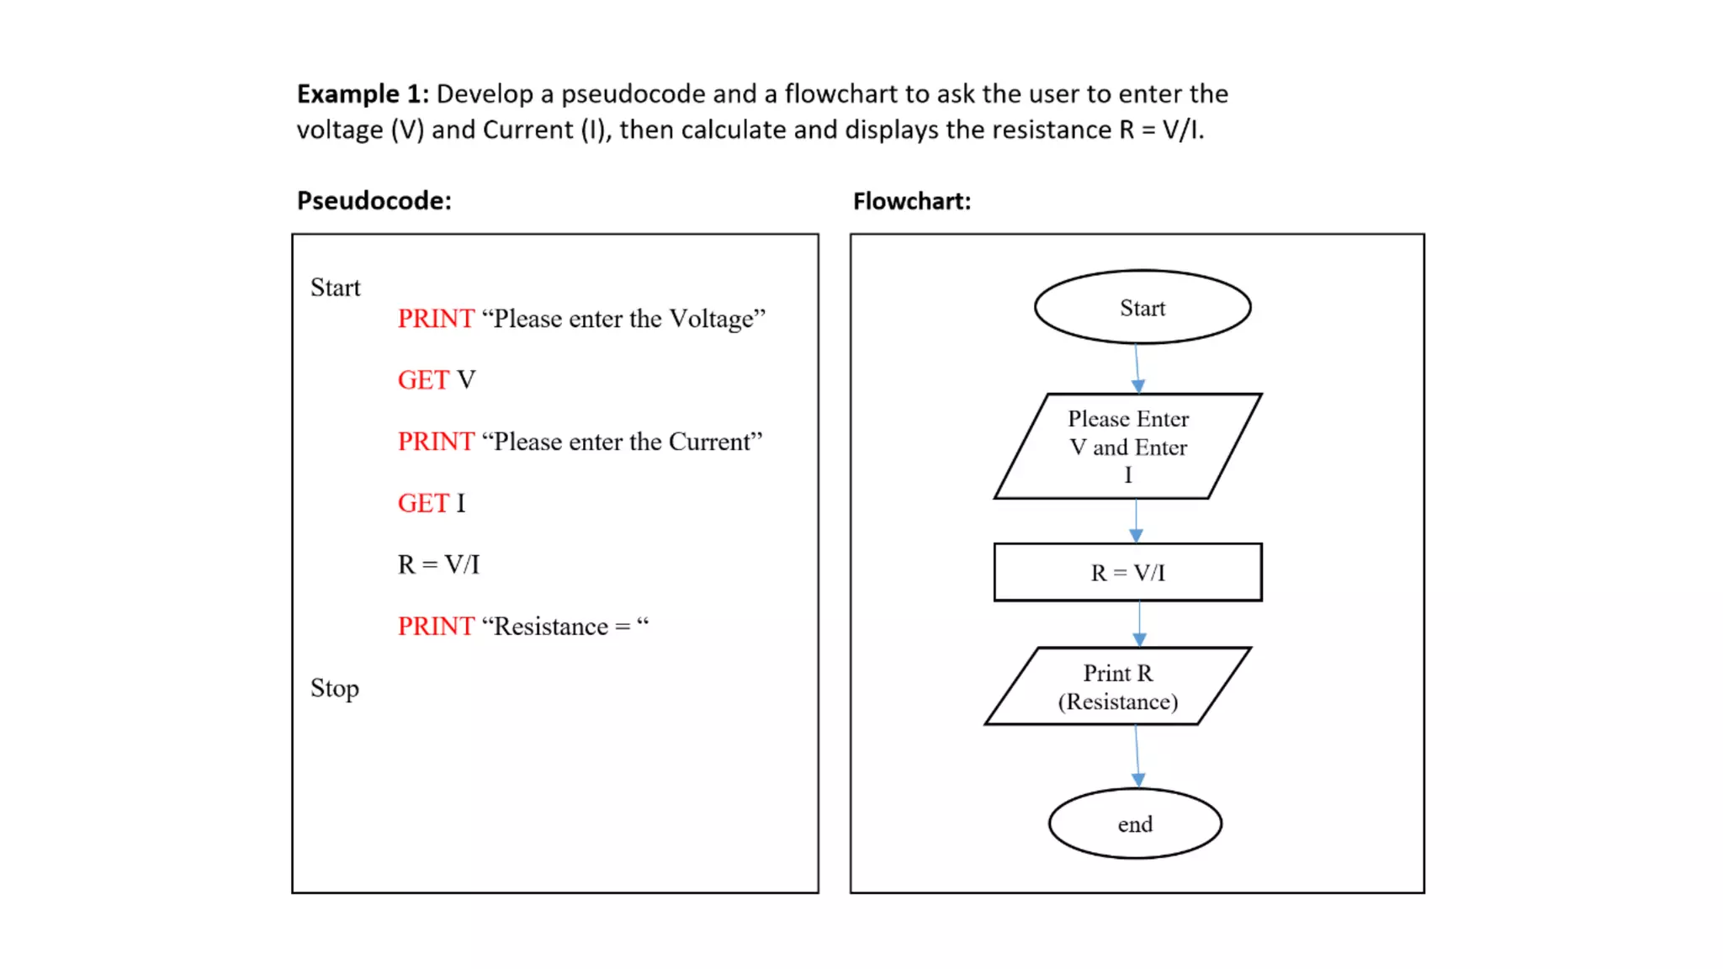

Slide 25
Definition of a Problem
Identifying inputs, processes, and expected outputs.
Example: Write a program to calculate the average of three numbers.

Slide 26
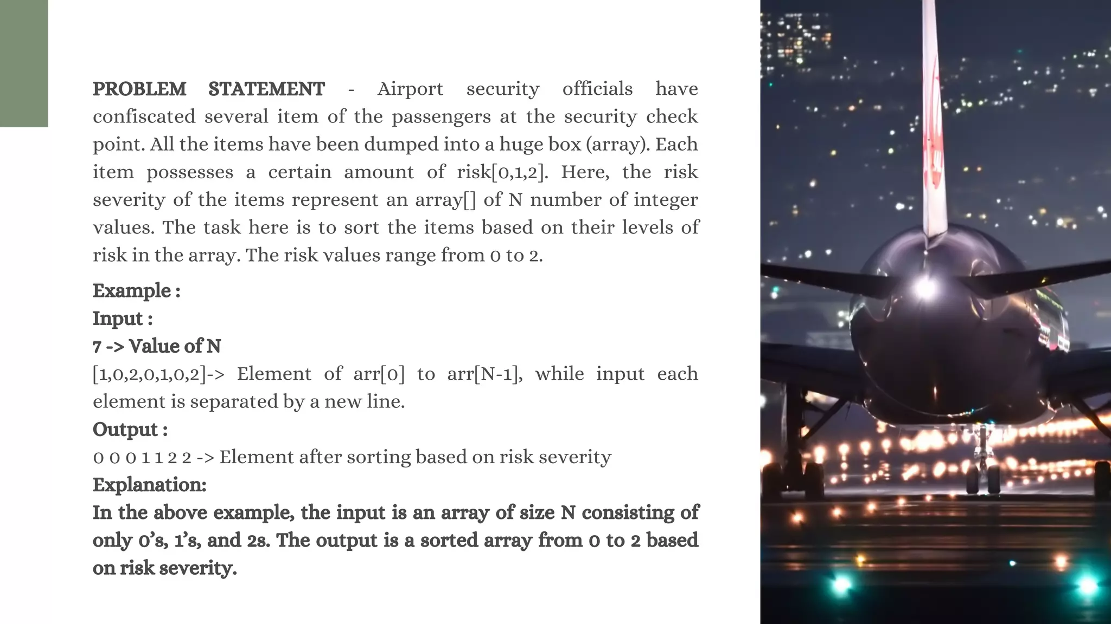

Slide 27
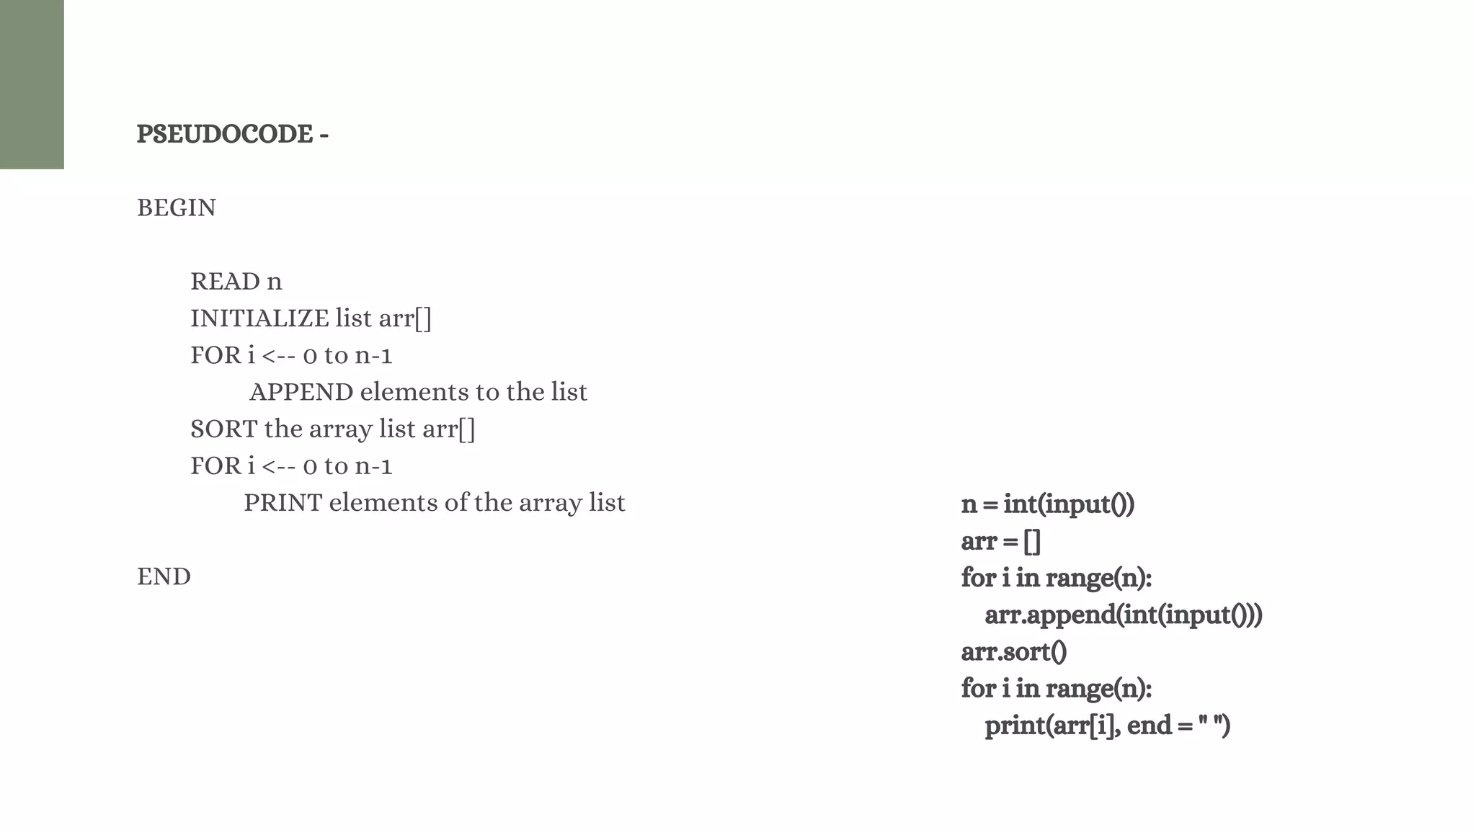

Slide 28
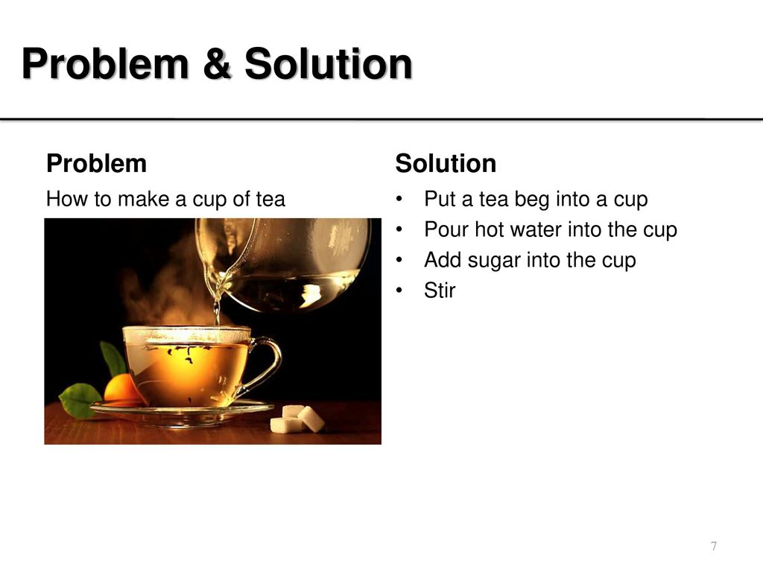

Slide 29
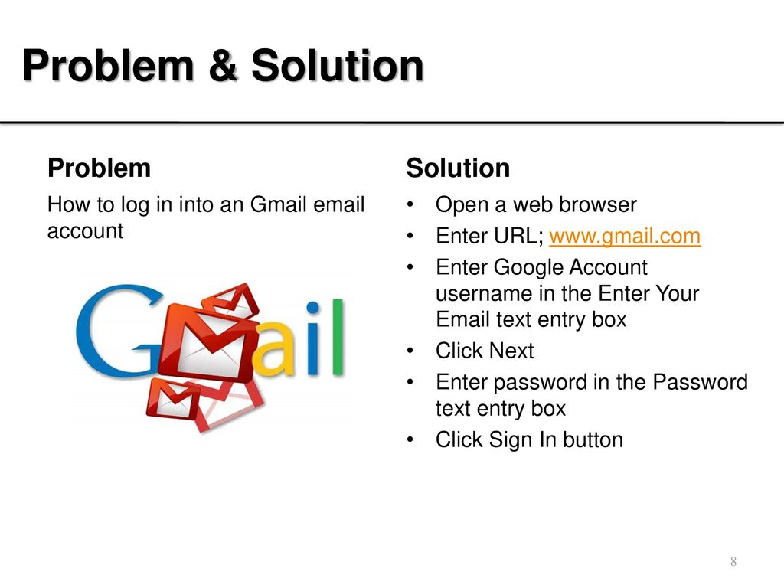

Slide 30
Program Design:
Writing clear and efficient algorithms.
Designing modular programs.
Best practices for program structure.

Slide 31
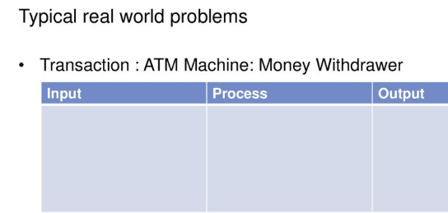
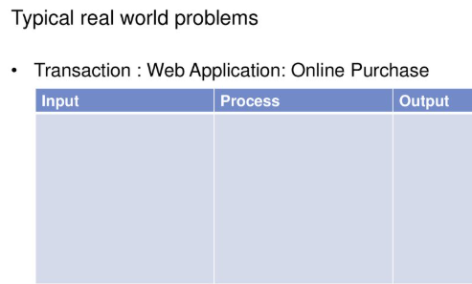

Slide 32
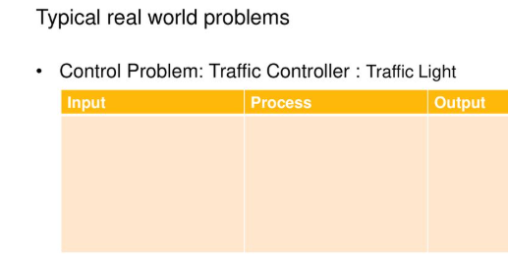
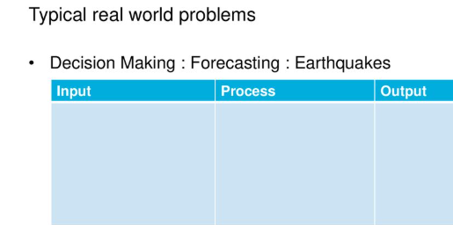

Slide 33
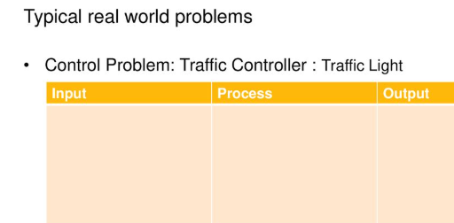
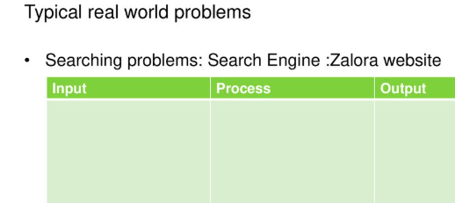

Slide 34
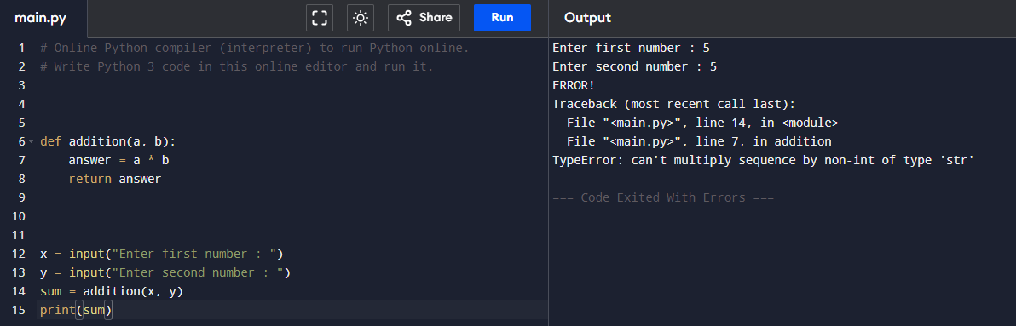
Debugging:
Understanding and fixing errors.
Common debugging techniques:
  Adding print statements.
  Using an Integrated Development Environment (IDE) debugger.
  Code reviews and walkthroughs.

Slide 35
Types of Errors in Programming:
Syntax Errors: Violation of programming language rules.
Runtime Errors: Errors occurring during program execution (e.g., divide by zero).
Logical Errors: Incorrect results due to flawed logic.

Slide 36
Documentation:
Importance of comments and clear code.
Writing documentation for users and developers.
Best practices for readability and maintainability.

